Slide 1
Human Resources Command
Effective Writing for Evaluations

Slide 2
Role of the Rater / Senior Rater
Senior Rater is the “owner” of the Evaluation and is responsible for timely completion
Mentor / Develop / Counsel your subordinates
Support Form – tool available to aid in defining / guiding goals and objectives throughout rating period; provides feedback to rated individual
Understand how our Evaluation Systems works
Fairly and accurately assess subordinates - participate in counseling
Senior Rater narrative is key: Exclusive vs. Strong Narrative to describe subordinate
Quantify potential…identify your best
Be Careful… What you don’t say is just as damaging as what you do say
Verify / Certify your subordinates on how to assess – ask them to bring their counselings and assessments with them to their counseling
Understand how to manage your Senior Rater profile - develop your rating philosophy
Anticipate and project “next” Evaluation
Current “THRU Date” on file plus 12 months or known changes of rater
“Complete the Record” dates for those being considered by a board
Monitor when reports are required, that they’re submitted on time, and unit rating schemes are current and accurate (Leader responsibility)

Slide 3
Evaluation Narrative
Selection boards should not have to guess – Send a clear message
Raters focus on specifics to quantify and qualify performance
Senior raters need to amplify their potential box checks by using the narrative to clearly convey the appropriate message to selection boards
Quantify and qualify the passion that the senior rater has for the rated Soldier’s performance and potential by using:
Exclusive narratives that clearly describe superior performance/potential (e.g., #1 or my best, top 5%, #2 out of 10, must select for Command / CSL, promote BZ / SZ)
Strong narratives that describe significant performance and enthusiastically recommend promotion (e.g., outstanding performance, one of my best, promote now)
Be careful with your narrative:
What is not said can have the same impact as what is said
Don’t say the same thing for all your people; boards can easily detect repeated verbiage
Avoid using the same verbiage year-to-year for the same Soldier
Cannot mention box check or board language in the narrative (e.g., “MOST QUALIFIED Soldier”, “6+ Soldier”, “If my profile allowed, I would rate this Soldier higher.”)

Slide 4
Senior Rater Consistency
Senior raters need to amplify their potential box checks by using the narrative to clearly send the appropriate message to selection boards. The following classification of types of narratives may serve as a guide and assist in sending a clear message:
Exclusive narratives – those which clearly describe superior performance / potential above that of the vast majority; associated with early promotion and are restrictive in nature (e.g., top 1%, 3%, 5%, etc. of all Soldiers, the best among a select grade or group, promote below the zone / secondary zone)
Should only be used:
for the best MOST QUALIFIED reports within a mature profile
for HIGHLY QUALIFIED reports that follow a MOST QUALIFIED report for the same rated Soldier
with discretion, for the very best Soldiers with HIGHLY QUALIFIED reports in small population / immature profile situations
Strong narratives – those which describe significant performance accomplishments and enthusiastically recommend promotion, assignment to key duty positions linked to upward mobility and appropriate military schooling (e.g., among the best, easily in the top third, definitely promote this Soldier, below the zone / secondary zone potential, one of my best Soldiers)
for MOST QUALIFIED reports
should be used for the very best Soldiers receiving HIGHLY QUALIFIED reports
Enumeration – a technique used to rank order Soldiers in a particular grade based on demonstrated performance and / or potential; typically used with exclusive narratives

Slide 5
Senior Rater Consistency (Cont.)
The best rater and senior rater narratives:
Are short; tell a simple story about the quality of Soldier being evaluated; focus on potential 3-5 years out
Quantify rated Soldier’s value relative to peers and do so in concert with senior rater box check
Many narratives are internally inconsistent:
Quantifying (e.g., “top 2% of my Captains / Sergeants First Class”) with a small population
Stating “the best ever” – with three in the population and a Highly Qualified label
Some phrases and clichés are counterproductive or overused:
“Stellar” “Hit the ground running”
“Consummate” “Unlimited potential”

Slide 6
Senior Rater Narrative Tips
Don’t Exaggerate
“A future GO,” “will be the best BDE CDR” (1LT)
“A future SGM,” “will be the best BDE CSM” (SFC)
“In fact, skip CPT and promote to MAJ.” (1LT)
“In fact, skip MSG and promote to SGM.” (SFC)
“If I could prove it, is a LTC disguised as a CPT.”
“If I could prove it, is a MSG disguised as a SSG.”
“Always promote and school early.”
Don’t Be Frivolous
“Eats taskings like candy.”
“Gleam in his eye, fire in his belly.”
“Midas touch of gold.”
“This officer / NCO justifies every dollar spent on recruiting.”

Slide 7
What Board Members Say
“Senior raters invariably have the most influence in how the board judges an individual Soldier’s performance.”
“It is imperative that raters and senior raters use clear, quantifiable descriptions in their comments for secondary and primary zone selections.”
“The Army must encourage, or impose, discipline on senior rater narratives….Inflated narratives could dilute the clear message of superior performance conveyed by a MOST QUALIFIED report in the future.”
“Those senior raters who were clear in identifying not only those Soldiers with great potential and performance, but also substandard performance or Soldiers possessing limited potential and poor performance of duty greatly enhanced the selection process.”
“Raters and senior raters must clearly and concisely quantify and qualify a Soldier’s potential and performance. Those raters that did both enhanced the selection process for top performers. Senior rater comments lose credibility when they state that a Soldier is the best or is in the top percentile of Soldiers rated and then give the Soldier a Highly Qualified rating when they have a mature profile.”
“Promotion potential recommendations did not always match Future Duty Assignment recommendations; this may indicate a lack of candid mentoring.”

Slide 8
Sample Exclusive Narratives (OER)
MAJ XXXXX is my #1 major of the 27 I currently senior rate, and one of the best officers that I’ve seen in over 25 years of service – top 1%. Already shows Battalion Command potential, a must-promote BZ to LTC and Battalion Command. Send to SSC at the earliest opportunity – a future senior leader in the Corps and the Army.
CPT XXXXX is in the top 5% of all the captains I rate and the #1 logistician in the battalion. CPT XXXXX’s outstanding work ethic and logistical expertise have led to the success of countless training operations, support taskings, and the overall success of this battalion. CPT XXXXX possesses unlimited potential. Promote below the zone to MAJ and send to ILE. She has the skillset to be an outstanding Battalion Commander.

Slide 9
Sample Exclusive Narratives (NCOER)
CSM XXXXX ranks #1 of the 21 CSMs I currently senior rate. She is a must select to immediately attend the Command Sergeant Major / Sergeant Major Executive Education Course. Outstanding performance. Continue to select her for successive nominative positions such as Division CSM, ASCC CSM, or ACOM CSM. Her potential is unlimited.
SGM XXXXX’s potential is unlimited and without a doubt in the top 5%. He is one of the most knowledgeable and professional NCOs that I’ve worked with in 33 years of service. His contributions to XXXXX’s mission have been absolutely invaluable and have raised those around him to higher levels of performance. An absolute must select for Brigade CSM. Send to the Senior Leader Keystone Course.
1SG XXXXX ranks #1 of 4 First Sergeants I currently senior rate and is among the best senior NCOs within the battalion. Already operating in a Battalion CSM capacity, he is a must select for SGM with unlimited potential. Immediately select for SGM at first look, followed by assignment to the resident Sergeants Major Academy.

Slide 10
Sample Strong Narratives (OER)
MAJ XXXXX is my #4 major of the 27 I currently senior rate, and one of the best officers that I’ve seen in over 25 years of service – easily top 10%. Already shows Battalion Command potential; promote to LTC and select for Battalion Command followed by SSC.
Superb! MAJ XXXXX’s performance in an extremely difficult and challenging assignment has been absolutely outstanding. MAJ XXXXX’s rare skills and abilities clearly separate her from her peers and make her the right choice for the difficult jobs that require innovative planning, meticulous execution, and extra effort. Absolutely unlimited potential. Promote ahead of peers and assign to tough positions of maximum responsibility. A truly superior officer.

Slide 11
Sample Strong Narratives (NCOER)
MSG XXXXX possesses limitless potential to serve as a Sergeant Major. Immediately select for USASMA and assign as a Senior Career Management NCO. He is in the top 20% of the Master Sergeants I have senior rated in my 25 years. He has clearly demonstrated that he truly cares about Soldiers.
SFC XXXXX rates as among the best and is #2 of 6 Platoon Sergeants I senior rate. Her contributions to the Army, her Soldiers, and the local community make her a definite selection to Master Sergeant ahead of her peers. SFC XXXXX should continue to be placed in leadership positions with increased responsibilities. Assign as First Sergeant, she will excel.
SFC XXXXX is an exceptional NCO with unlimited potential. He is #3 of 8 SFCs that I senior rate. Promote ahead of peers to Master Sergeant and select for First Sergeant at the earliest opportunity. His unequivocal duty performance and proven competence was evident as he served as the Rear Detachment NCOIC while the unit was deployed to JRTC.

Slide 12
Example NCOERs

Slide 13
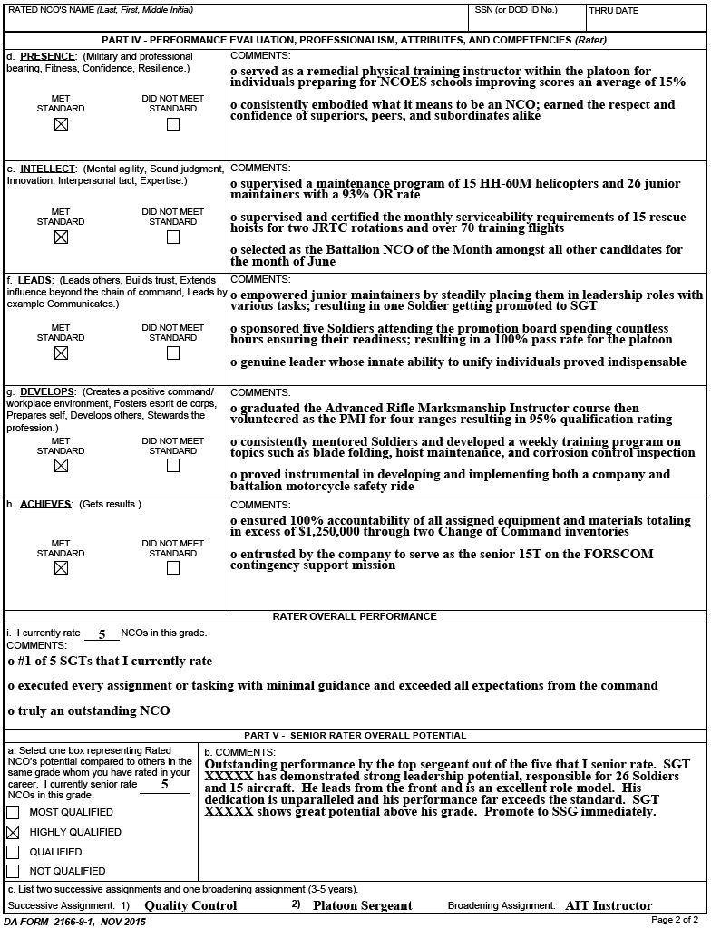
DA Form 2166-9-1 (SGT)
HIGHLY QUALIFIED

Slide 14
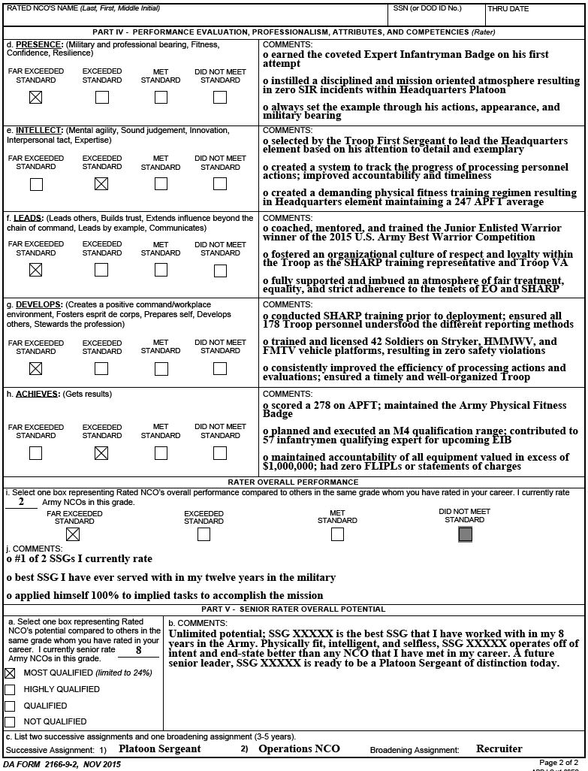
DA Form 2166-9-2 (SSG)
MOST QUALIFIED and FAR EXCEEDED STANDARD

Slide 15
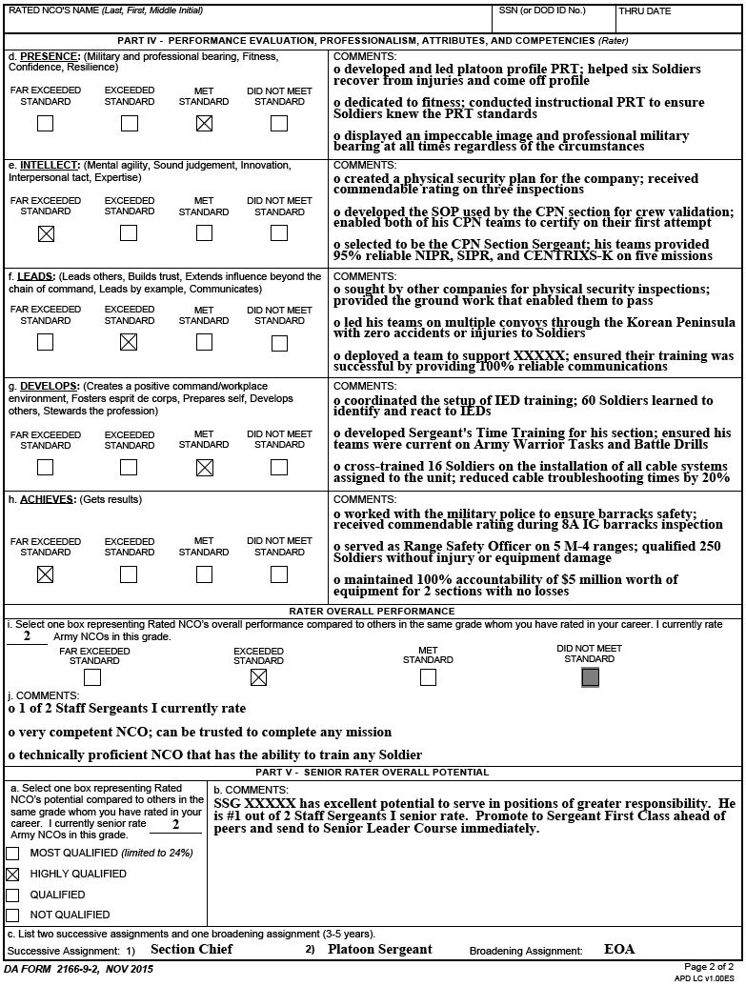
DA Form 2166-9-2 (SSG)
HIGHLY QUALIFIED and EXCEEDED STANDARD

Slide 16
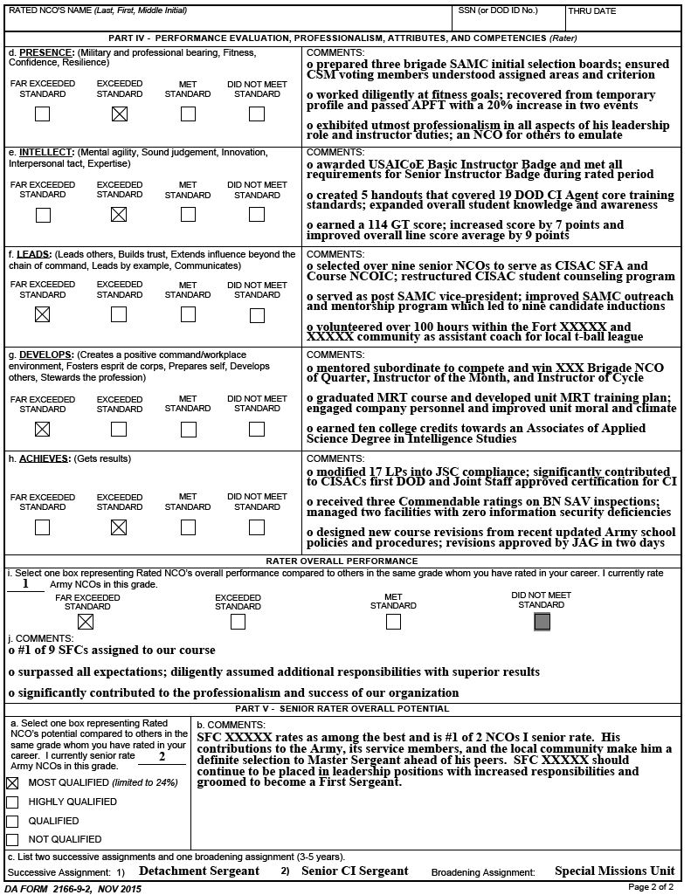
DA Form 2166-9-2 (SFC)
MOST QUALIFIED and FAR EXCEEDED STANDARD

Slide 17
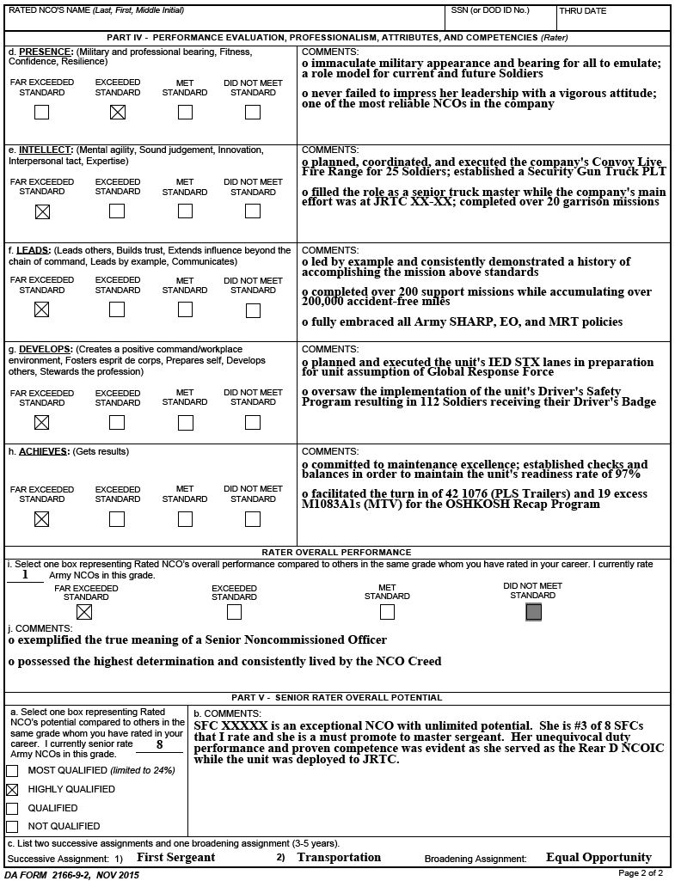
DA Form 2166-9-2 (SFC)
HIGHLY QUALIFIED and FAR EXCEEDED STANDARD

Slide 18
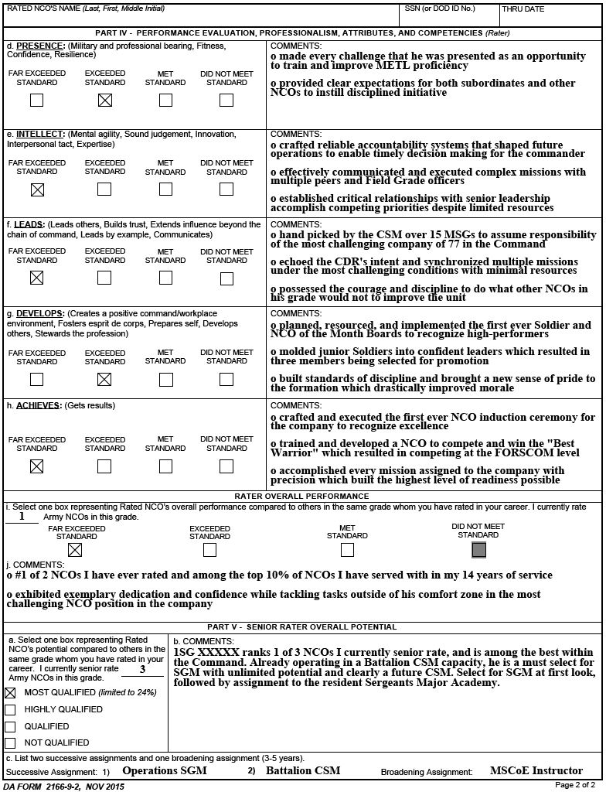
DA Form 2166-9-2 (1SG)
MOST QUALIFIED and FAR EXCEEDED STANDARD

Slide 19
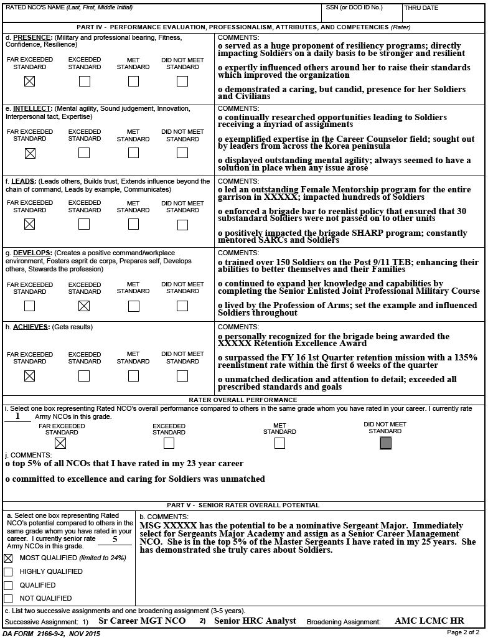
DA Form 2166-9-2 (MSG)
MOST QUALIFIED and FAR EXCEEDED STANDARD

Slide 20
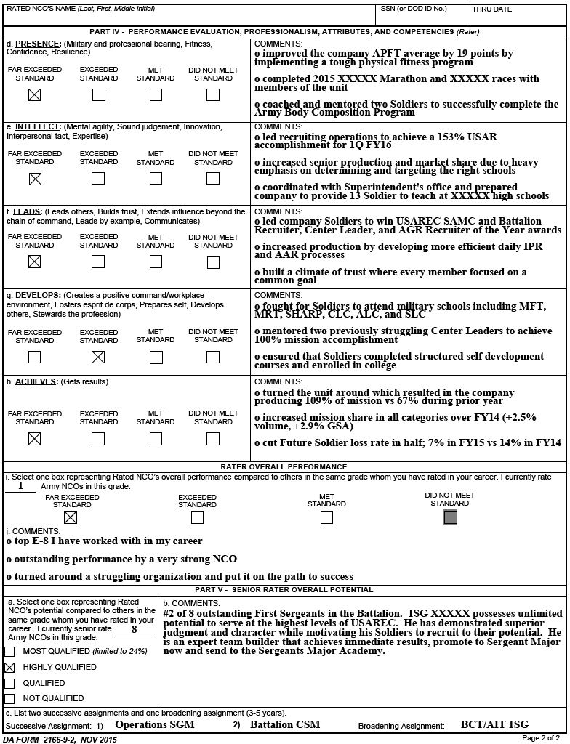
DA Form 2166-9-2 (1SG)
HIGHLY QUALIFIED and FAR EXCEEDED STANDARD

Slide 21
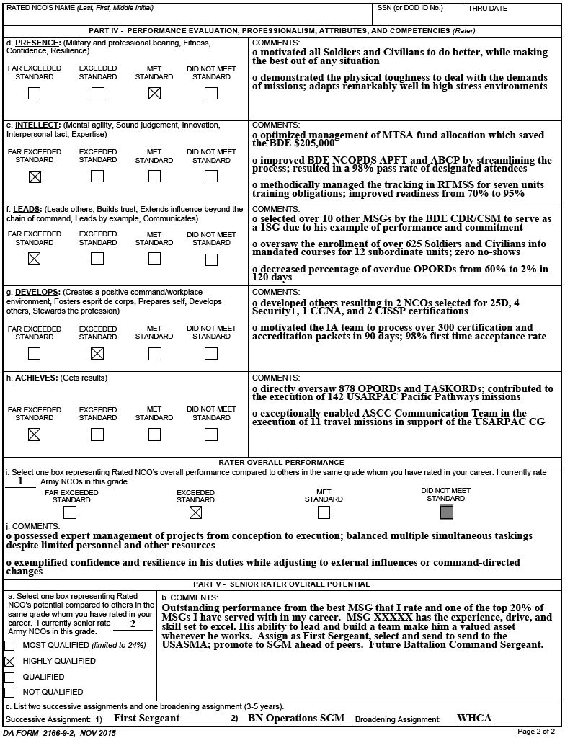
DA Form 2166-9-2 (MSG)
HIGHLY QUALIFIED and EXCEEDED STANDARD

Slide 22
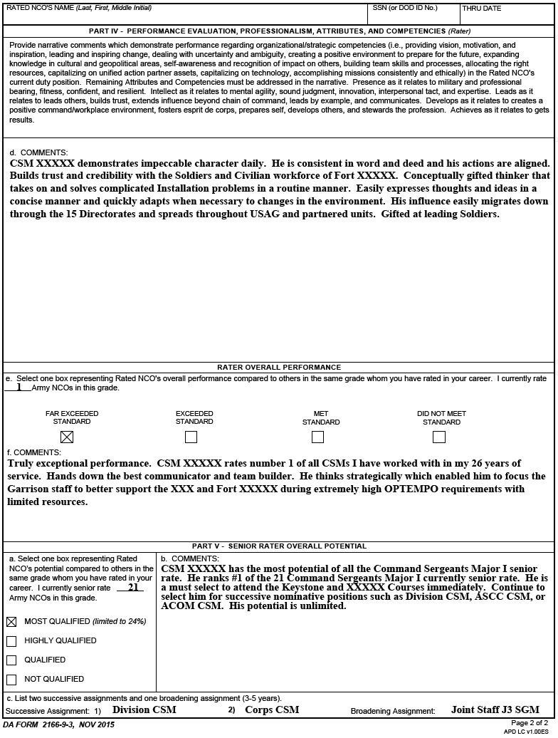
DA Form 2166-9-3 (CSM)
MOST QUALIFIED and FAR EXCEEDED STANDARD

Slide 23
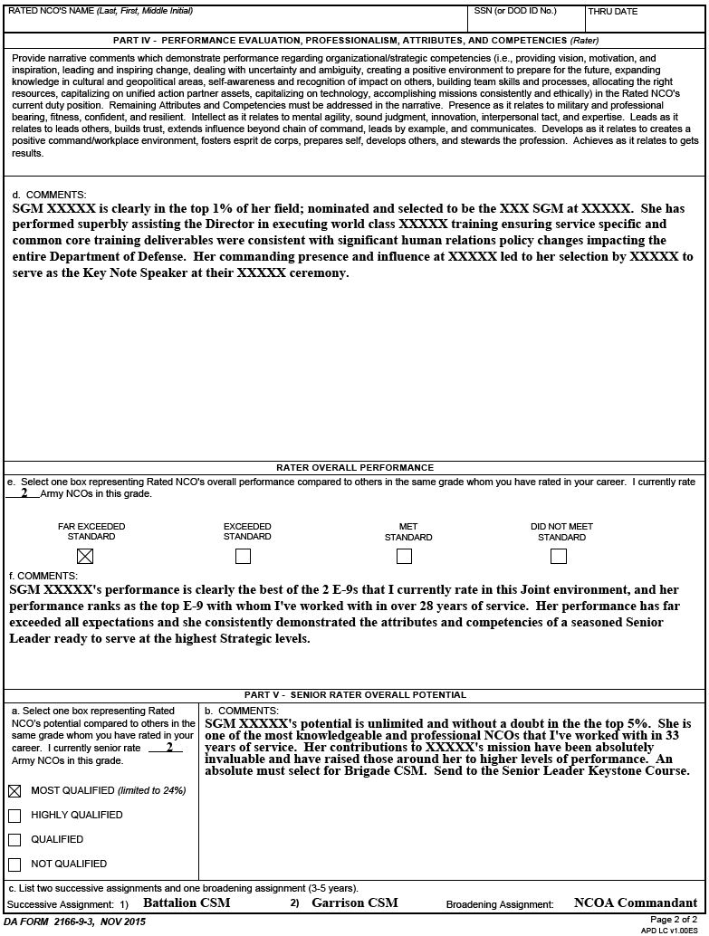
DA Form 2166-9-3 (SGM)
MOST QUALIFIED and FAR EXCEEDED STANDARD

Slide 24
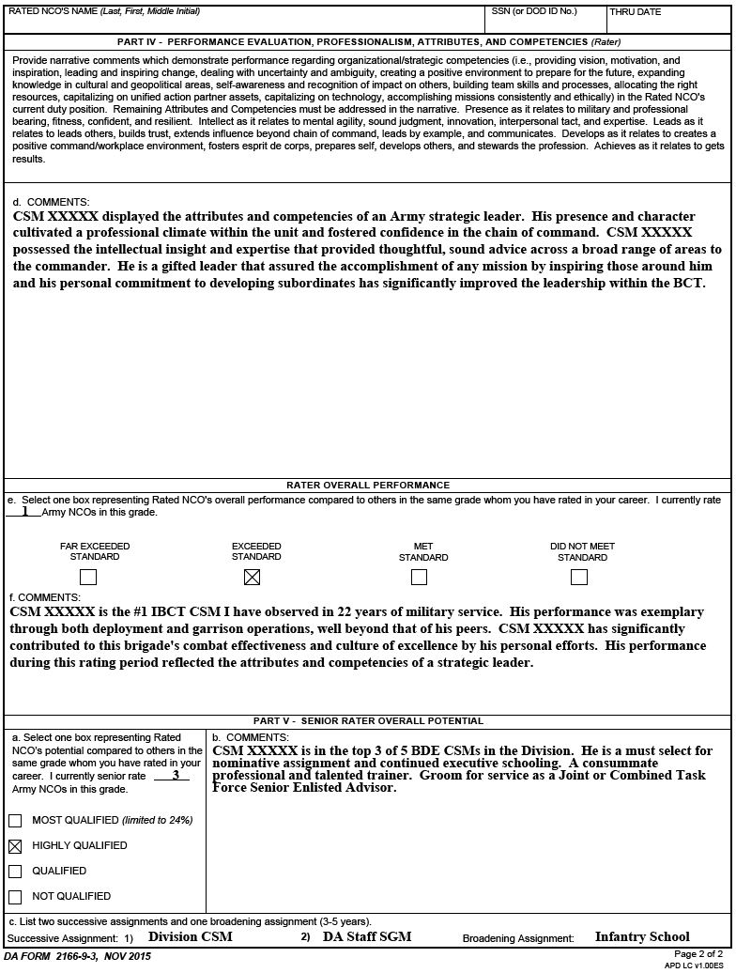
DA Form 2166-9-3 (CSM)
HIGHLY QUALIFIED and EXCEEDED STANDARD

Slide 25
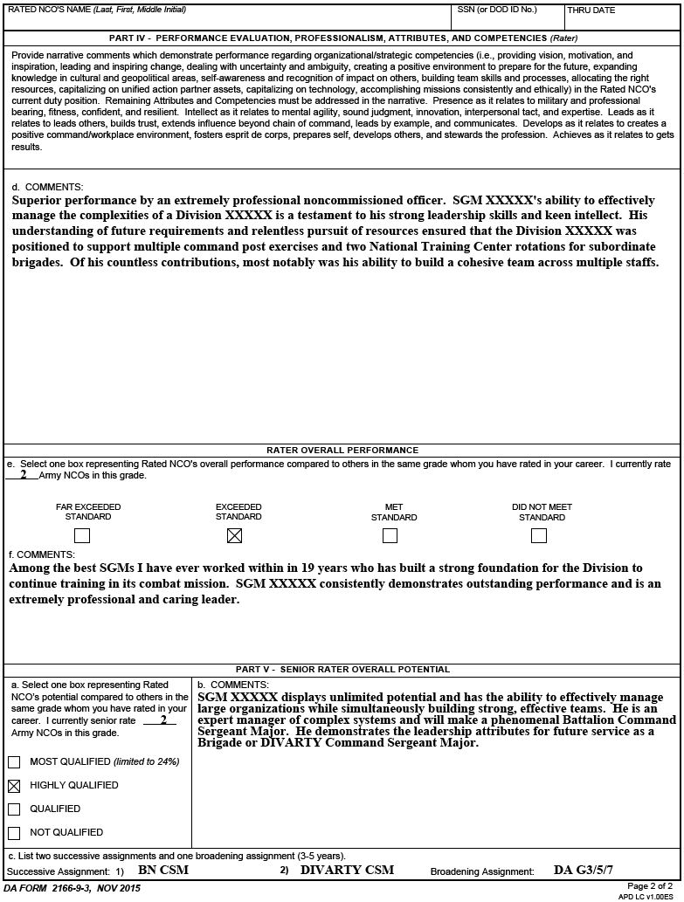
DA Form 2166-9-3 (SGM)
HIGHLY QUALIFIED and EXCEEDED STANDARD

