Slide 1
Annual Unit Refresher/ Pre- & Post-Deployment Training
1

Slide 2
Terminal Learning Objective
Action Demonstrate behavior consistent with the Army’s Sexual Harassment/Assault Response and Prevention (SHARP) Program
Condition In a classroom environment, with facilitated group discussions, student handouts, videos, and simulated real-life scenarios involving potential and actual sexual harassment and sexual assault.
Standard Describe the impact of sexual harassment and sexual assault on the Army, examine strategies to prevent sexual harassment and sexual assault, discuss support resources available to complainants of sexual harassment and victims of sexual assault, penalties for sexual harassment and sexual assault offenders, and DOD Sexual Assault Prevention and Response (SAPR) and Army SHARP Program. Participate in all discussions and complete practical exercises with 100 percent accuracy.
Video (CSA)

Slide 3
The Impact
COMMUNITY
Higher Rates of
Violent Crime
Instability
Diminishes
Community
Relations
Degradation
to Community
UNIT
Disrupts Good Order
And Discipline
Loss of
Safety
Loss of Unit
Cohesion and
Teamwork
Undermines
Readiness
Loss of
Personnel
Low
Morale
INDIVIDUAL
Self Blame
Isolation
Individual
Avoidance
Anxiety
Fear
Depression
Anger
Reduction in
Performance
Less
Productive
Bottom Line: Sexual harassment and sexual assault endanger lives of individuals and threaten the Army’s mission.

Slide 4
Historical Timeline
VICTIM FOCUS
OFFENDER FOCUS
Reactive
Proactive
1964
1981
1982
1988
1991
1997
2003
2004
2008
2014
Title VII
Aberdeen
Sexual Harassment/Assault Response & Prevention (SHARP)
Merit Systems Protection Board (MSPB) Survey
Dept. of Defense Task Forces
Air Force Academy
Prevention of Sexual Harassment (POSH) Training Requirement
Tailhook
Sexual Assault Prevention and Response Office (SAPRO)

Slide 5
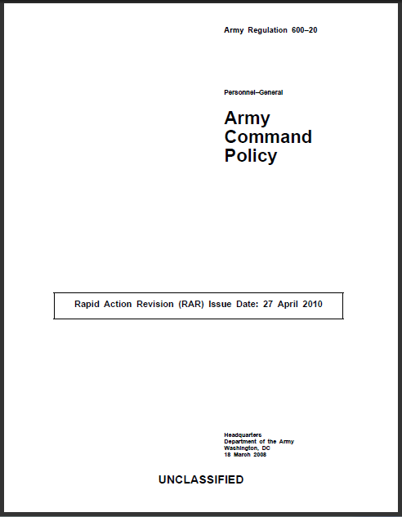
Definition of
Sexual Harassment
What is Sexual Harassment?
Sexual harassment is a form of gender discrimination
Sexual harassment includes unwelcomed sexual advances, requests for sexual favors, and other verbal or physical conduct of a sexual nature when:
Submission to or rejection of is made a term or condition of a person’s job, pay, career;
Submission to or rejection of is used as a basis for career or employment decisions;
Conduct has the purpose or effect of unreasonably interfering with an individual’s work performance or creates an intimidating, hostile, or offensive work environment

Slide 6
Definition of Sexual Assault
What is Sexual Assault?
Sexual assault is a crime.
Sexual assault is defined as: Intentional sexual contact characterized by the use of force, threats, intimidation or abuse of authority or when the victim does not or cannot consent.
The term includes a broad category of sexual offenses of the following specific UCMJ offenses: rape, sexual assault, aggravated sexual contact, abusive sexual contact, forcible sodomy (forced oral or anal sex), or attempts to commit these offenses.
DODI 6495.02, 28 MAR 2013
Notes:
Add a copy of the front of the DODI 6495.02

Slide 7
Sexual Harassment vs. Sexual Assault
What is the difference between sexual harassment and sexual assault?
Sexual Harassment
Sexual Assault
Sexual harassment involves verbal, nonverbal, and physical behaviors
Sexual assault involves “sexual contact” as defined in Article 120 of the Uniform Code of Military Justice (UCMJ)

Slide 8
Continuum of Behaviors
Sexual Innuendo
Sexual Harassment
Sexual Assault
Mutually consenting/safe
Mutually flirtatious/playful
Inappropriate or non-mutual
Sexual
harassment
Sexual
assault
Less severe
More severe
Intervention opportunities

Slide 9
BREAK
Notes:
READ PRIOR TO DISMISSING CLASS:
We will take a short 5 minute break before beginning the video
Any civilian employee who wants to excuse themselves from the video and its corresponding discussion should return in __ minutes; according to the clock in the room, that would be ____ (insert return time).

Slide 10
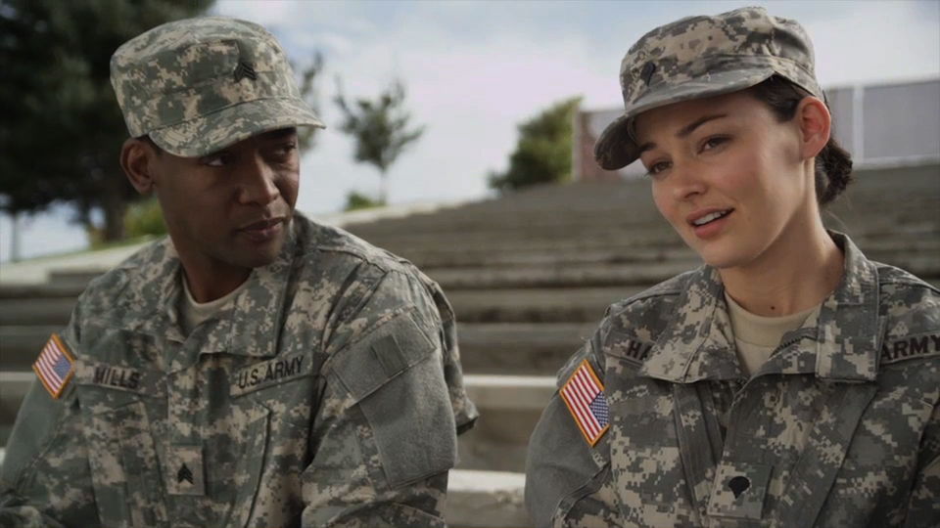
Real Time Impact, Part II
Orientation Video

Slide 11
BREAK
Notes:
We will take a short break; please be back at ____ (should match the return time given prior to the video).

Slide 12
Army Policy on Sexual Harassment
Sexual harassment is unacceptable and will not be tolerated
Sexual harassment destroys teamwork and negatively affects combat readiness
Army leadership at all levels will be committed to creating an environment conducive to maximum productivity and respect for human dignity
The success of the mission can be achieved only in an environment free of sexual harassment for all personnel
The prevention of sexual harassment is the responsibility of every Soldier and Department of the Army (DA) Civilian and Family members; leaders set the standard for Soldiers and DA Civilians to follow
Ref: AR 600-20

Slide 13
Sexual Harassment Checklist
Is the behavior sexual in nature?
Is the behavior unwelcomed?
The harasser’s intent is NOT the determining factor
Would a reasonable person find the behavior to be inappropriate?
Apply the “Reasonable Person Standard”
One or more of the following:
Do the elements of power, control, or influence exist?
Does the behavior create a hostile or offensive environment?

Slide 14
Categories of Sexual Harassment
Verbal
Telling sexual jokes
Using sexually explicit profanity or threats, sexually oriented cadences, or sexual comments
Whistling in a sexually suggestive manner
Describing certain attributes of one’s physical appearance in a sexual manner
Using terms of endearment in referring to Soldiers, DA Civilians, or Family members
Nonverbal
Staring at someone, blowing kisses, winking, or licking one’s lips in a suggestive manner
Displaying inappropriate printed material (e.g., sexually oriented pictures or cartoons)
Using sexually oriented screen savers on one’s computer
Sending sexually oriented notes, letters, faxes, or e-mail
Physical contact
Touching, patting, pinching, bumping, or grabbing
Cornering or blocking a passageway
Kissing
Providing unsolicited back or neck rubs

Slide 15
Types of Sexual Harassment
Quid Pro Quo/Sexual Coercion (“This for That”)
Demanding sexual favors in exchange for a promotion, award, or favorable assignment
Disciplining or relieving a subordinate who refuses sexual advances
Threatening a poor job evaluation for refusing sexual advances
Hostile Environment
Subjected to offensive, unwanted, and unsolicited comments or behaviors of a sexual nature. If these behaviors unreasonably interfere with an individual’s performance, then the environment is classified as hostile
Derogatory, gender-biased terms
Sexually suggestive pictures or jokes
Unwanted touching
Remember, a third party—not just the object of the attention—can also view behaviors as sexually harassing!

Slide 16
Sexual Harassment Policy Distinctions
Military
DA Civilians
Policy applies on and off duty hours
The workplace is all the time (including off duty) and everywhere (including barracks, etc.)
Victims do not have the right to sue the offender
Victims are encouraged to confront offenders; however, supervisors/ managers are responsible for confronting offenders once they know of the harassment.
Formal complaints are managed by the commander.
Soldiers have 60 calendar days from the date of the alleged incident in which to file a formal complaint.
Family members are eligible to file complaints
Policy only applies while on duty.
The workplace is more narrowly defined to the actual office/workplace and areas associated with working.
Victims have the right to sue through the administrative process provided in 29 Code of Federal Regulations (CFR) Part 1614.
Victims are encouraged to confront the offender also; however, supervisors/ managers are responsible for confronting offenders once they know of the harassment.
Formal complaints are managed by Equal Employment Opportunity (EEO) personnel.
DA Civilians must contact the EEO Office within 45 days of the harassment.
REF: AR 690-600

Slide 17
Practical Exercise 1: Scenario A
Ms. Leslie Robinson, a DA Civilian, works in the “cube farm” environment. One day, Staff Sergeant (SSG) Bill Evans stopped by Specialist (SPC) Mark Fields’ cubicle to talk about Ms. Robinson’s breasts and butt. SSG Evans told SPC Fields that he would like to take Ms. Robinson back to the barracks and “let her teach him a few things.” Ms. Robinson did not hear any of it, but two other co-workers, Sergeant (SGT) John Weaver and SPC Tina Michaels did. SGT Weaver observed that SPC Michaels was uncomfortable with the conversation.
Later in the day, SSG Evans and SPC Fields passed SPC Michaels and SGT Weaver in the break room, after which SPC Michaels confides in SGT Weaver that she does not want to work with SSG Evans nor SPC Fields. She says that was not the first off-color remark she has heard from SSG Evans, and she doesn’t want to work with him if that’s how he is going to talk about women. SPC Michaels also mentioned that she was going to tell Ms. Robinson about the remarks when she returned to the office in the morning.
The next morning, SPC Michaels tells Ms. Robinson about SSG Evans’ comments. Ms. Robinson becomes very angry and decides to file a complaint with her non-commissioned officer in charge.

Slide 18
Practical Exercise 1: Scenario B
SPC Jonathan Williams is assigned to Bravo Company and services information technology (IT) equipment at a Forward Operating Base in Afghanistan. Captain (CPT) Rebecca Switzer is SPC Williams’ company commander. One evening, CPT Switzer asks SPC Williams to come to her hooch to repair her laptop. While SPC Williams is working, CPT Switzer takes off her uniform and walks around in her bra and panties. She then walks up behind SPC Williams and begins rubbing his shoulders. SPC Williams says he needs to go back to his office to do some work. CPT Switzer says, “If you give me what I want, I’ll make sure that you are able to go home on R&R in time for your son’s birthday.” SPC Williams insists that he has to get back to the office. The next day, he avoids CPT Switzer and informs First Sergeant (1SG) Mary Green of the incident.

Slide 19
Practical Exercise 1: Scenario C
Carla Olsen is the 18-year-old daughter of Sergeant First Class (SFC) Roger Olsen from Fort Bragg, North Carolina (NC). While at the Post Exchange one summer day, Carla and her friend, Britney, decide to have lunch. When Britney bends down to pick up some change she dropped, PFC Ryan Allen comments on the tattoo on her lower back. Just then, SPC Sam King walks by and whistles at Carla. Carla looks over at him and he winks and licks his lips. Carla looks at him, frowns, and shakes her head. She asks him what unit he’s from, but he ignores her and walks away.

Slide 20
Responses to
Sexual Harassment
Direct approach
Confront the harasser and inform the person that the behavior is not appreciated or welcomed and that it must stop
Focus on behavior and its impact—offer behavior-centered feedback
Indirect approach
Address the harasser without a face-to-face conversation (e.g., send a letter)
Third-party assistance
Ask someone else to talk to the harasser, to accompany the complainant, or to intervene on behalf of the complainant to resolve the conflict
Chain of command
Report the behavior to your immediate supervisor or others in the chain of command and ask for assistance in resolving the situation
File a formal complaint

Slide 21
Complaint Check
Description Formal Complaint Informal Complaint
Subject to
Timelines
Not filed in
Writing
Requires an official
investigation
Requires a reprisal
plan
21

Slide 22
Admin & UCMJ Sexual Harassment Penalties
Admin Penalties
Mandatory counseling
Discharge from service
Bar to re-enlistment
Adverse performance evaluations
Relief for cause
Administrative reduction
Admonition
Reprimand
Admin withholding of privileges
Rehabilitative transfer to another unit
UCMJ Penalties
Offense | Article | Maximum Penalties
Failure to obey order or regulation | 92 | Bad Conduct Discharge (BCD), 6 months confinement, and forfeiture of all pay and allowances
Cruelty and maltreatment | 93 | Dishonorable Discharge, 1 yr confinement, and forfeiture of all pay and allowances
Provoking speeches or gestures | 117 | 6 months confinement and forfeiture of 2/3 of all pay and allowances for 6 months
Indecent language | 134 | BCD, 6 months confinement, and forfeiture of 2/3 of all pay and allowances

Slide 23
Army Policy on Sexual Assault
Sexual assault is a criminal offense.
It degrades mission readiness.
Soldiers who are aware of a sexual assault incident should report it immediately (within 24 hours).
Sexual assault is incompatible with Army Values and is punishable under the UCMJ and other federal and local civilian laws.
All victims of sexual assault will be treated with dignity, fairness, and respect.
Applies 24/7 On and Off Post

Slide 24
Restricted vs. Unrestricted Reporting
Restricted Report | Unrestricted Report
Benefits Access to medical, advocacy, legal, and counseling services Receive the Sexual Assault Forensic Examination (SAFE) Control the release of personal information Can change to Unrestricted Report at any time | Benefits Access to medical, advocacy, legal, and counseling services Receive the SAFE Alleged offender may be held accountable Command support Can receive protective order (Military Protective Order [MPO] or Civilian Protective Order [CPO])
Limitations The alleged offender will not be held accountable Ineligible for expedited transfer or reassignment No command support Cannot receive a protective order | Limitations More people will know about the sexual assault Investigation may be intrusive and difficult Cannot change to Restricted Report

Slide 25
Filing Restricted vs. Unrestricted Reporting Con't
Restricted Report | Unrestricted Report
Who can file a report: SARC/SHARP Specialist VA/SHARP Specialist Healthcare Provider | Who can file a report: SARC/SHARP Specialist VA/SHARP Specialist Healthcare Provider CID Commander JAG IG
Limitations Chaplains – can not file a report, but remains confidential | Limitations More people will know about the sexual assault Investigation may be intrusive and difficult Cannot change to Restricted Report

Slide 26
Definition of Consent
What is Consent?
Consent will not be deemed or construed to mean the failure by the victim to offer physical resistance. Consent is not given when a person uses force, threat of force, or coercion or when the victim is asleep, incapacitated, or unconscious.
A person cannot consent to sexual activity if he or she is substantially incapable due to:
Mental impairment or unconsciousness resulting from consumption of alcohol, drugs, or a similar substance
Mental disease or defect which renders the person unable to understand the nature of the sexual conduct at issue
Physically declining participation in the sexual conduct at issue
Physically communicating unwillingness to engage in the sexual conduct at issue

Slide 27
Obtaining Consent: Scenario 1
SSG Emily Barnes calls SSG Kevin Nash to pick her up from a bar and take her home. Though heavily intoxicated, SSG Barnes asks SSG Nash to walk her up to her apartment, where she tells him she wants to have sex with him. Once they enter her apartment, SSG Barnes begins kissing SSG Nash. SSG Nash kisses her back and asks, “Where is your bedroom?” SSG Nash guides SSG Barnes to her bedroom and he begins to undress. While he’s undressing, SSG Barnes lays back and passes out. SSG Nash undresses SSG Barnes and begins performing oral sex on her attempting to arouse her even though she is passed out.
Has SSG Nash obtained consent from SSG Barnes in this situation?

Slide 28
Obtaining Consent: Scenario 2
SGT David Kenworthy and SPC Olivia Clark are off-base and begin making out. SGT Kenworthy begins to undress SPC Clark, who “seems to want it.” As they kiss, she says “yes” but as he goes to remove her skirt, she says “no” and places his hands back on her shoulders.
Has SGT Kenworthy obtained consent from SPC Clark in this situation?

Slide 29
BREAK
Notes:
READ PRIOR TO DISMISSING CLASS:
We will take a short 5 minute break before beginning the video
Any civilian employee who wants to excuse themselves from the video and its corresponding discussion should return in __ minutes; according to the clock in the room, that would be ____ (insert return time).

Slide 30
Real Time Impact, Part I
Soldier Training Video

Slide 31
BREAK
Notes:
We will take a short break; please be back at ____ (should match the return time given prior to the video).

Slide 32
Rule 514
A victim has a privilege to refuse to disclose and to prevent any other person from disclosing a confidential communication made between the victim and a victim advocate, in a case arising under the UCMJ, if such communication was made for the purpose of facilitating advice or supportive assistance to the victim.
“Confidential communication” also applies to records the Sexual Assault Response Coordinator (SARC)/SHARP and Victim Advocate (VA)/SHARP Specialists maintain pertaining to communications with the victim. These communications with SARC/SHARP and VA/SHARP Specialists and their associated records are considered privileged and are not to be released to others, including to commanders or law enforcement personnel.
DTFSAMS

Slide 33
Expedited Transfer Requests
Sexual assault victims who file an unrestricted report can request an expedited transfer/reassignment from their current unit
The request must be submitted in writing using DA Form 4187
Commander (battalion or above) has 72 hours to recommend approval or disapproval of the request if he or she cannot otherwise approve the request
The transfer or reassignment may be:
Another unit at a different geographical location*
A different unit on the installation
Another company within the same battalion
Another battalion within the same brigade
Another brigade within the same division
*All permanent change of station (PCS) requests must be approved by the commander of Human Resources Command (HRC)

Slide 34
Protective Orders
Military Protection Order (MPO)
Will remain in effect until such time as the commander terminates the order or issues a replacement order
Issuing commander shall notify the appropriate civilian authorities of any change made in a protective order, or its termination and the termination of the protective order, or its issuance if the Soldier and any individual involved does not reside on a military installation at any time during the MPO
Are not enforceable by civilian authorities off post. Off-base violations of the MPO should be reported to the issuing commander, Department of Defense (DOD) law enforcement, and Criminal Investigation Division (CID) for investigation
Civilian Protection Order (CPO)
Shall have the same force and effect on a military installation as such order has within the jurisdiction of the court that issued such order

Slide 35
Ensuring Victim Safety: Scenario
SSG Barnes wakes up the next day and realizes that while she was passed out, SSG Nash had sex with her. She confronts him, and he informs her that she “wanted it.” SSG Barnes decides to file a report, and SSG Nash calls her to tell her that unless she drops the charges, he will “see to it that she regrets it.” SSG Barnes fears for her safety since SSG Nash is also in her unit, so she decides to file an Unrestricted Report and approaches the SARC/SHARP Specialist to ask about options for her safety and an expedited transfer.
How long is an MPO in effect?
Who has to be notified of the MPO?
Are MPOs enforceable by civilian law enforcement? Does she have any other off-base options?
After the commander receives SSG Barnes’ expedited transfer request, how much time does he/she have to make a decision?
If SPC Barnes’ transfer request involved a permanent change of station (PCS), who has the authority to approve?

Slide 36
Types of Offenders
Nonstranger
Most common type of sexual assault; includes acquaintance rape, drug-facilitated rape, and marital rape
Stranger
Stranger rape is less likely to occur than nonstranger rape
Gang and multiple rapes
Victim usually knows or has been acquainted with at least one member of the group
Drug-facilitated sexual assault
Believed to be increasing

Slide 37
Bystander Intervention
Process
1. Notice the event along a continuum of behaviors
2. Interpret the event or behavior as a problem
3. Feel responsible for solving the problem
4. Choose how to intervene
5. Build the culture to eliminate the problem

Slide 38
Civilian & UCMJ Sex Offense Penalties
U.S. Code 18, Chapter 109 (Civilian) Penalties
Offense | Section | Maximum Penalties
Aggravated Sexual Abuse | 2241 | 20 years in prison
Sexual Abuse | 2242 | 20 years in prison
Sexual Abuse of a Minor or Ward | 2243 | 15 years in prison
Abusive Sexual Contact | 2244 | 10 years in prison
Sexual Abuse Resulting in Death | 2245 | Death, life in prison
UCMJ Penalties
Offense | Article | Maximum Penalties
Rape | 120 | Death
Sexual Assault | 120 | Dishonorable Discharge, forfeiture of all pay and allowances, 30 years confinement
Aggravated Sexual Assault | 120 | 20 years + Dishonorable Discharge and forfeiture of all pay and allowances
Abusive Sexual Assault | 120 | Forfeiture of all pay and allowances, 7 years + Dishonorable Discharge
Sodomy | 125 | Dishonorable Discharge, forfeiture of all pay and allowances, confinement for life without parole

Slide 39
Campaign Lines of Effort & SHARP Initiatives
Objective
Initiatives
Mutual respect/trust, professional values, reinforced to create environment where sexual assault is not tolerated.
Special emphasis Pre-commissioning Training, Future Soldiers Training, and IMT
I. A. M. Strong SHARP Training integrated into all aspects of Soldier/Civilian ‘Life-cycle’ training
Publish Commander’s SHARP Guidebook to implement and maintain program
Revitalizing the Sponsorship Program through Command emphasis
Reviewing linkage of SHARP and increasing opportunities to women due to repeal of DGCAR
Prevention
Prevention
Special Victims Capability: Investigation/Prosecution training for CID agents and prosecutors
23 Special Victim Prosecutors Army-wide
22 Special Victim Investigators (Additional 7 X Investigators in FY14)
Team Approach: Coordination with CID &JAG on every SA case
Dedicated Paralegal Support (Directed Military Over strength) 2013
Victim Witness Liaison at every General Court-Martial Jurisdiction
Trial Counsel Assistance Program (TCAP) reach back assistance and direct support
Investigation
Investigative resources yield timely and accurate results.
Investigation
Revised Command Climate Survey Policy to address SHARP & increase commander awareness
Initiated BDE & BN Commander 360 Assessment Program
Implemented Policy to require mandatory OER comments addressing unit’s SHARP climate
Recurring CSA-led SHARP Summits with senior Army leadership
Developing rigorous screening and behavior health assessments for positions of trust
Expanded Commander’s legal courses
Sex Offenders OCONUS Reassignment & Retainability Policy
Accountability
Perpetrators & CofCs are held appropriately accountable.
Accountability
Quality services, support to instill confidence, inspire victims to report, restore resilience.
Recurring CSA-led SHARP Army Advisory Panel that includes victims
Building a Professional Team: SARC/VA Schoolhouse pilot course JAN ‘14; FOC in 4th Qtr, FY14
Increased role & presence of SARCs & VAs across our formations
Special Victim Counsel Program: reporting triggers multidisciplinary team approach to victim advocacy; program covers entire ‘life-cycle’ of case
Advocacy
Advocacy
Executed ‘Red Team’ Program in FY 2012-2013 to assess program effectiveness
Commander Risk Reduction Dashboard and Strategic Management System “SMS” reporting
ARI-led Field Focus Group Assessments, 1st & 2nd Qtr, FY14: Define perceptions of Army culture
Metrics used to measure compliance with current regulatory standards
Response Systems Panel support
GAO Audits on Sexual Assault in IMT & Male-on-Male Sexual Assault Prevention
Assessment
Meaningful, and accurate systems of measurement and evaluation.
Assessment

Slide 40
LOE Check
LOEs: Prevention, Investigation, Assessment, Advocacy, Accountability
Prevention
Ensure the chain of command understands that its responsibility is to create a positive command climate and environment of trust, dignity, and respect in which every Soldier, Civilian, and Family member can thrive and achieve their full potential by eliminating sexual harassment and sexual assault and stopping offenders from committing crimes.
Ensure that every report is examined thoroughly, fairly, and competently to make a positive impact upon the culture, command climate and ensure that victims feel free to report without fear of reprisal.
Ensure that the chain of command is fully engaged, holding every individual, unit, organization, and commander appropriately responsible for behaviors, actions, and inactions, and that it takes appropriate actions based upon investigations.
Provide compassionate, best-in-class care, support, and protection for victims, and protect the rights and privacy of survivors.
Analyze, evaluate, and improve the Army’s strategy, methods, and techniques for eliminating sexual harassment and sexual assault in its ranks using Army research and evaluations, as well as input from national experts in the field of prevention, response, and advocacy.
Investigation
Accountability
Advocacy
Assessment

Slide 41
SARC and VA
Responsibilities
Responsibility SARC VA
Provide care and
Support to victims
Process reports of
Sexual assault
Facilitate SHARP
Training
Enter data into
ICRS and DSAIDS
Securely store DD 2910
And DD 2911
Provide 24/7 response
capability
41

Slide 42
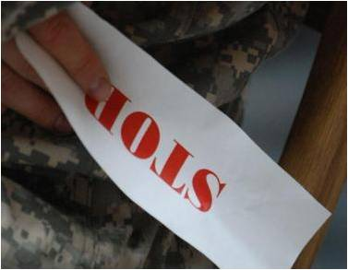
Command Responsibilities
for Prevention
Commanders will:
Lead by example
Establish a climate of prevention
Post written Army sexual assault and sexual harassment policy letters and victim services information
Ensure Soldiers and DA Civilian employees receive annual SHARP training
Ensure SHARP personnel are appointed at the appropriate unit level, are trained, and are certified
Conduct periodic assessments of the unit’s or organization’s SHARP Program

Slide 43
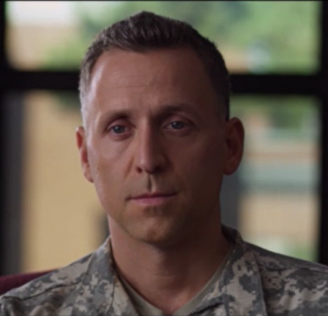
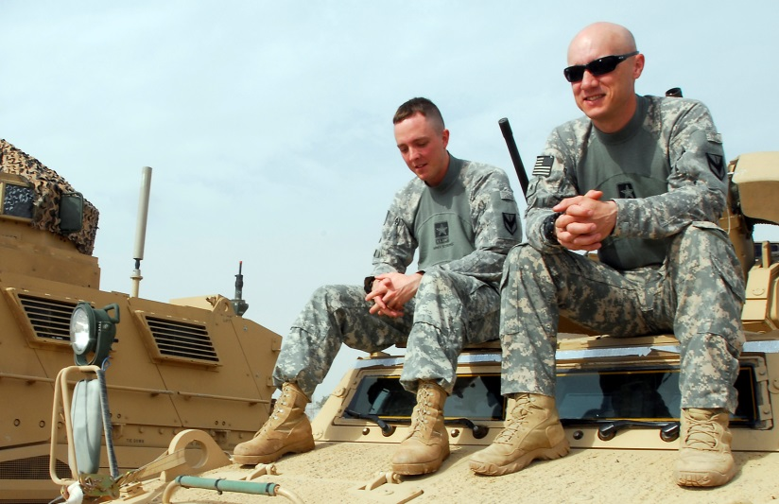
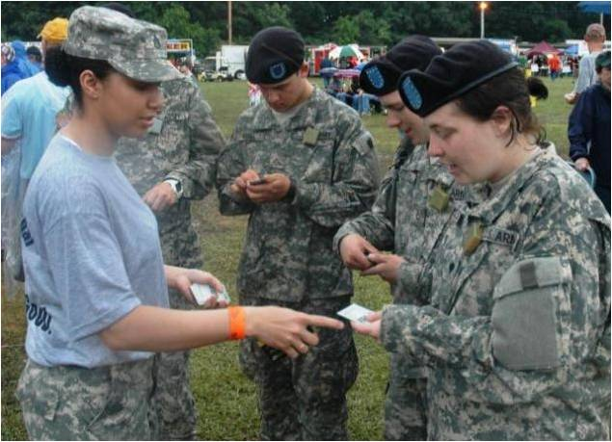
Whose Responsibility?

Slide 44
Strategy for Cultural Change
A good strategy to facilitate cultural change may include the following components
Knowledge of current status
Vision for the future
Goals
Training
Research
Participation

Slide 45
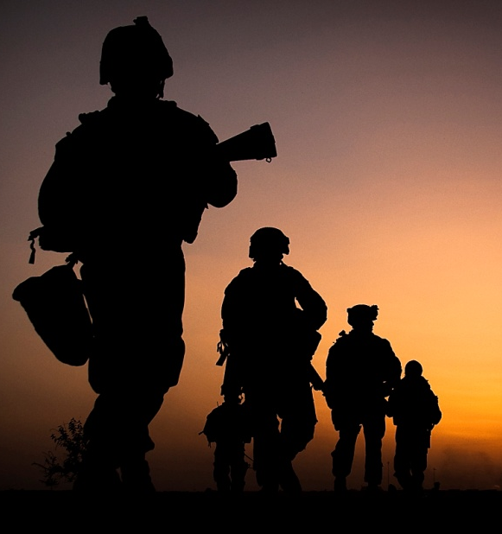
Summary
In this lesson, we described the impact of sexual harassment and sexual assault on the Army, discussed support resources available to complainants of sexual harassment and victims of sexual assault, penalties for sexual harassment and sexual assault offenders, and DOD Sexual Assault Prevention and Response (SAPR) and Army SHARP Program.

Slide 46
Reminder : If You Need Help
Installation 24/7 Helpline:
Insert your # here
DoD Safe Helpline:
(877) 995-5247

