Slide 1
How to find & apply for a Federal Tech Job Through USA JOBS

Slide 2
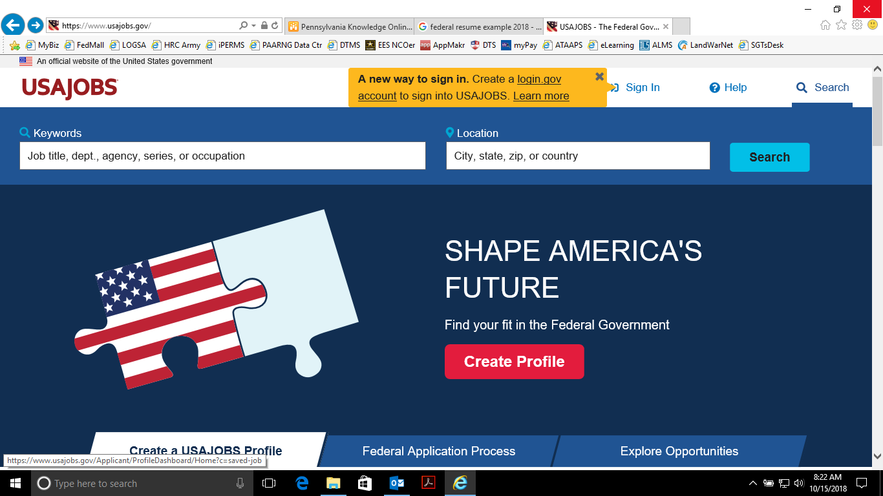
Search : “USAJOBS.Org” in your web browser
Once website is open, type in the location you wish to search in

Slide 3
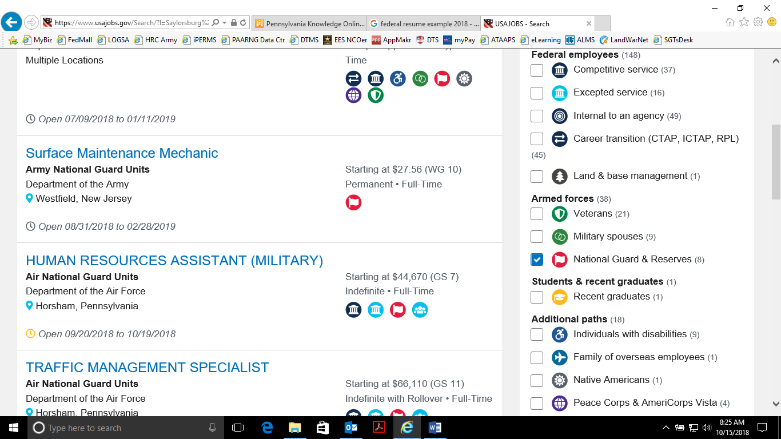
-Using the filters click “National Guard & Reserves” as well as expand your search radius
-Once the filters are applied all the results will be Tech jobs.
-Select the position you wish to apply for

Slide 4
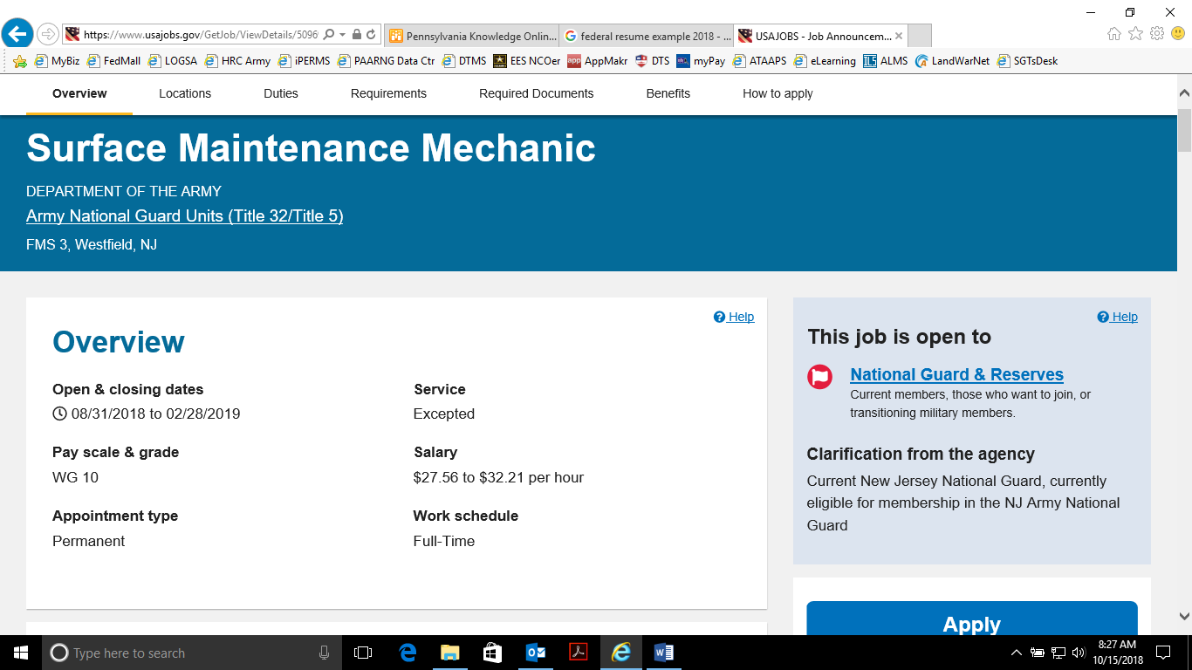
Once you’ve select the position you want to apply for, a page will open up. The page will have information about the position such as;
Opening & closing date
Pay Scale
Duties
Position compatibility requirements
Apply requirements
Announcement number

Slide 5
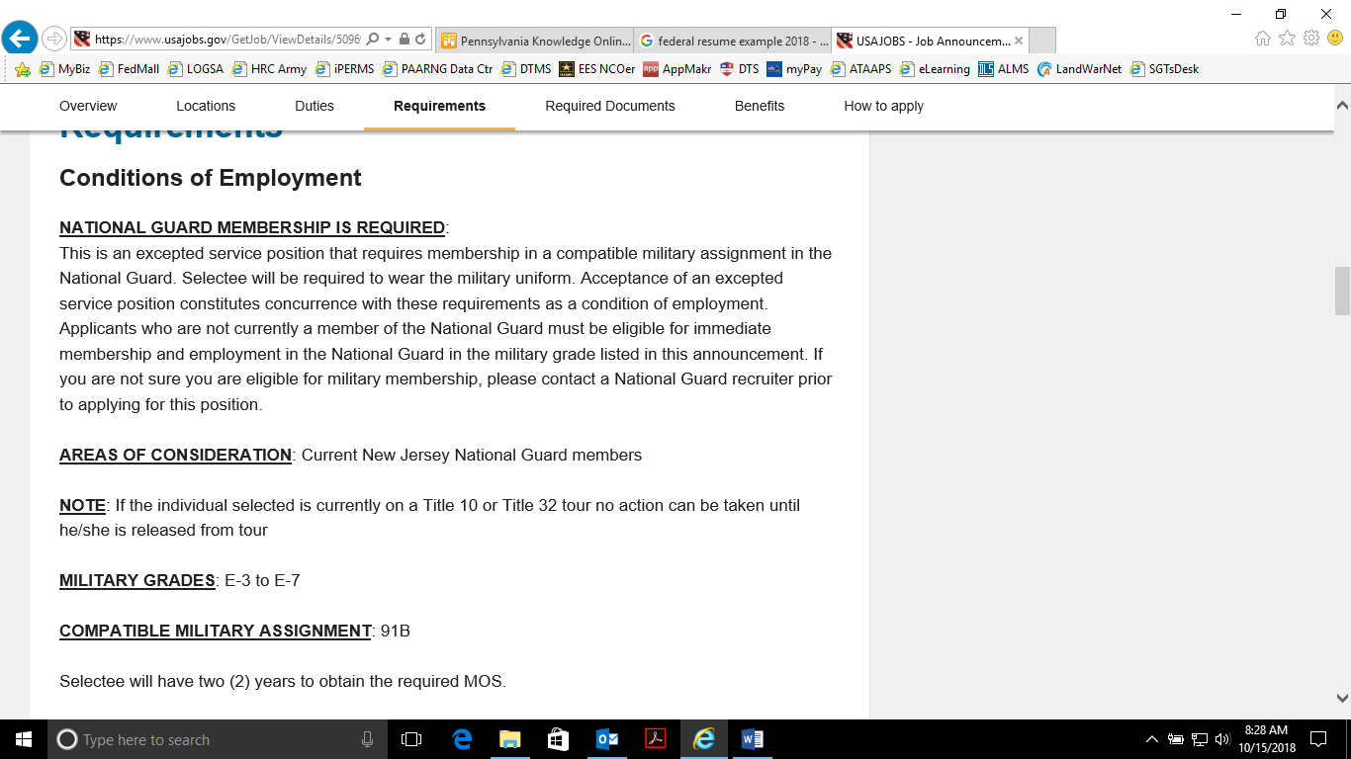
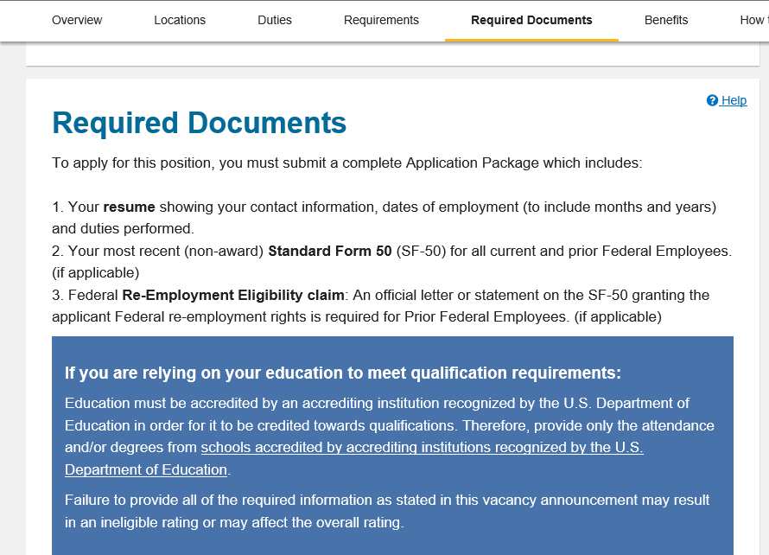
Once you’ve reviewed the position information, to apply click the “APPLY” button on the page. Next follow the prompt to complete the process.

Slide 6
How to build a resume
How to build a resume
To build a resume in USAJOBS:
1. Sign into USAJOBS.
2. Go to your Documents.
3. Make sure you’re in the Resumes section and select the Upload or build
resume button.
4. Click Build resume.
5. Name your new resume and click Next.
6. Click Add Work Experience, enter the required information and click Save
Work Experience. To add additional work experience repeat this step or
click Next to continue with your education information.
7. Click Add Education, enter the required information and click Save
Education. Repeat this step to add additional education or click Next to
continue with your references. You may also click Finish if you don’t want
to add more information

Slide 7
How to build a resume cont.
8. Click Add Reference, enter the required information and click Save
Reference. You may add up to five references on your resume. Repeat this step to add an additional reference or click Next to continue to the next step.
9. You can enter additional information on your resume such as job related
training, language skills, organizations/affiliations, professional publications,
and other information. Click the corresponding button under each section to
add your information, enter your information and click Add or Save for each
section once completed.
10. Click Finish to save your resume. Your new resume will appear in your
Documents list.
11. Click View on the resume icon to preview your resume. To edit your
resume click Edit on the resume icon and it will bring you to the first page
of your resume in the resume builder tool.
Save your work periodically

Slide 8
How to fill out the resume from USAJOBS.org

Slide 9
